Slide 1

Intercept Outcomes Tool
Operator Regulatory Performance Program

Slide 2

Contents
What is the Intercept Outcomes Tool?
How and where do I access the tool?
How do I authorise other users to view the tool?
Navigating the tool
What you can see and why
Notes:
Contents slide – Design 1

Slide 3
What is the Intercept Outcomes Tool?

Slide 4
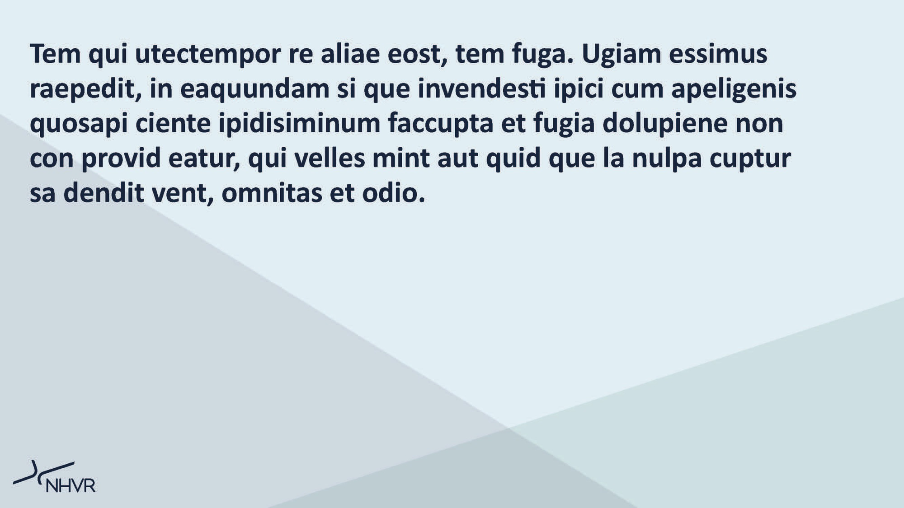
What is the Intercept Outcomes Tool?
Building on the current Compliance Module – Vehicle Defects, this tool expands the level of insight available to operators regarding their fleet performance.
The feature brings all fleet intercept information into one central, easy-to-access location.
The tool offers industry access to all NHVR-conducted intercepts and their outcomes, helping operators self-manage compliance, identify trends, and meet their HVNL obligations.
As part of a staged rollout, this tool is currently available to NHVAS operators. Release to all of industry is planned for a later date in 2026.

Slide 5
How do I access the tool?

Slide 6
How do I access the tool?
Access is limited to operators with an active NHVR Go account.
Users must verify their identity.
Vehicle registrations must be linked to the account.
Only Administrator users can authorise others to view the tool.
Users must be authorised by an Administrator to access the tool.
The tool can be accessed via NHVR Go.
Each of these items is explored in more detail.

Slide 7
Do I have an active NHVR Go account?

Slide 8
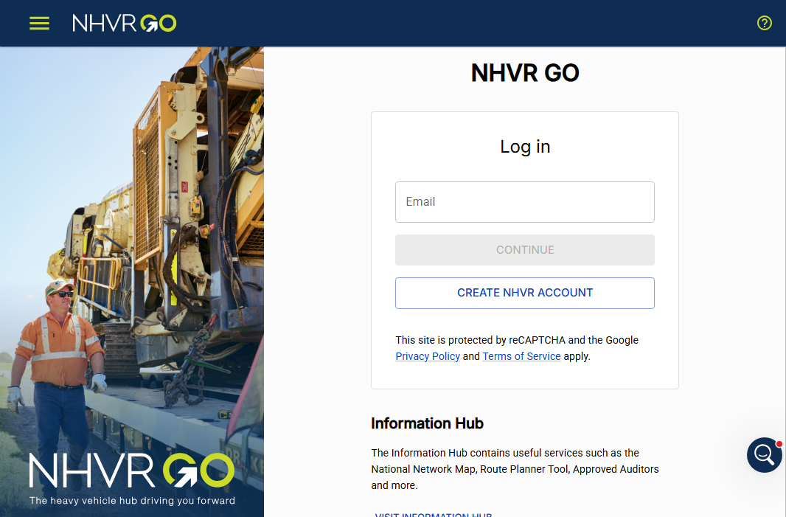
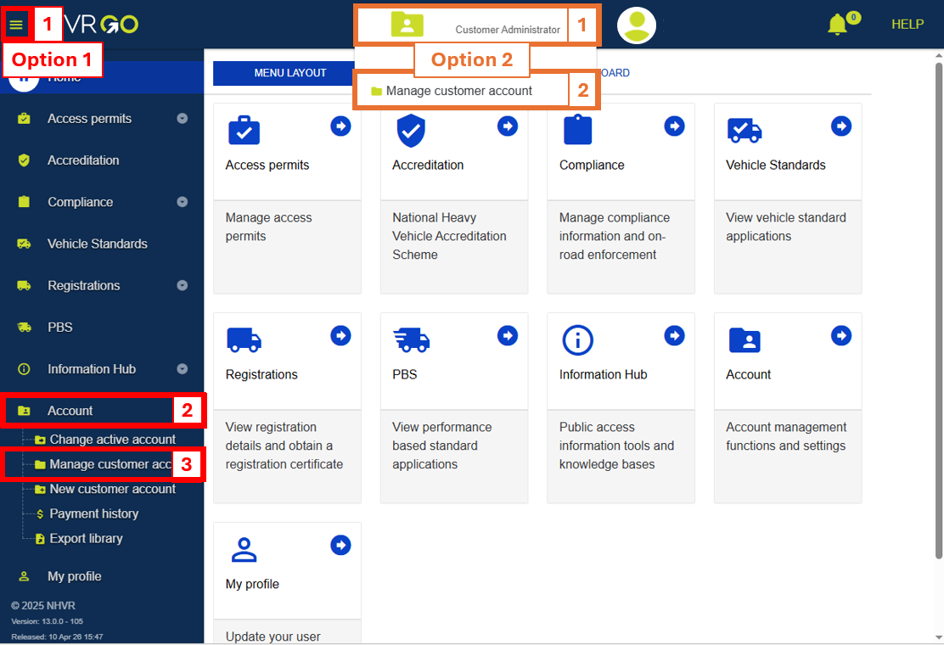
Do I have an active NHVR Go account?
Log in to your NHVR Go account.
Go to ‘Manage Customer Account’ page.

Slide 9
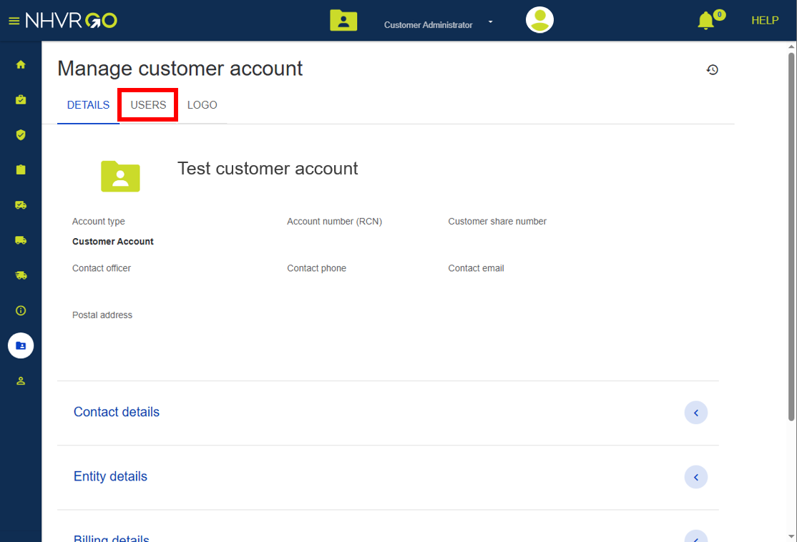
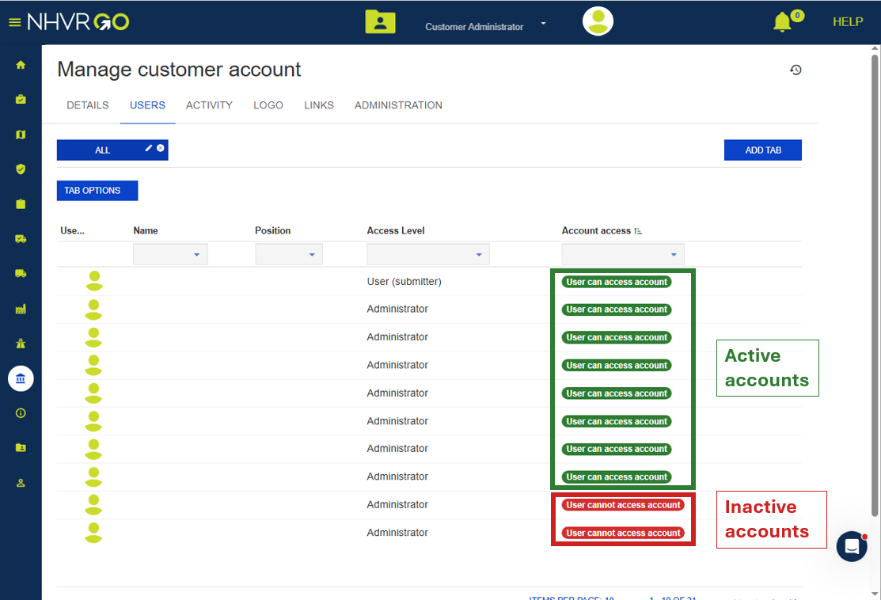
Do I have an active NHVR Go account?
Click the ‘Users’ tab
If ‘Account access’ says:
‘User can access account’ = Active account.
‘User cannot access account’ = Inactive account.
If your account is inactive, please reach out to an Administrator user to reactivate your account.

Slide 10
How do I verify my identity?

Slide 11
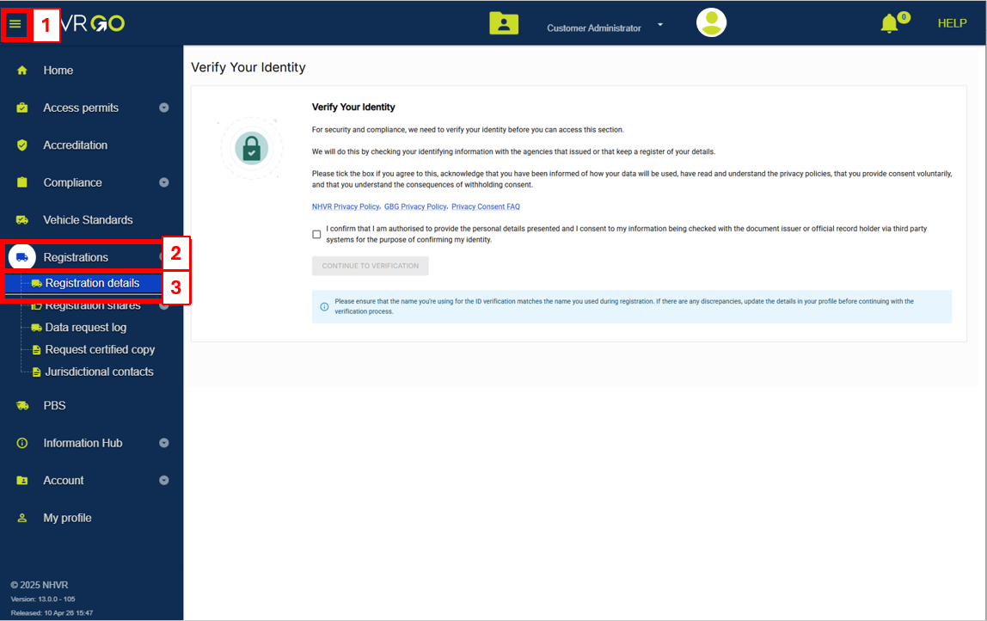
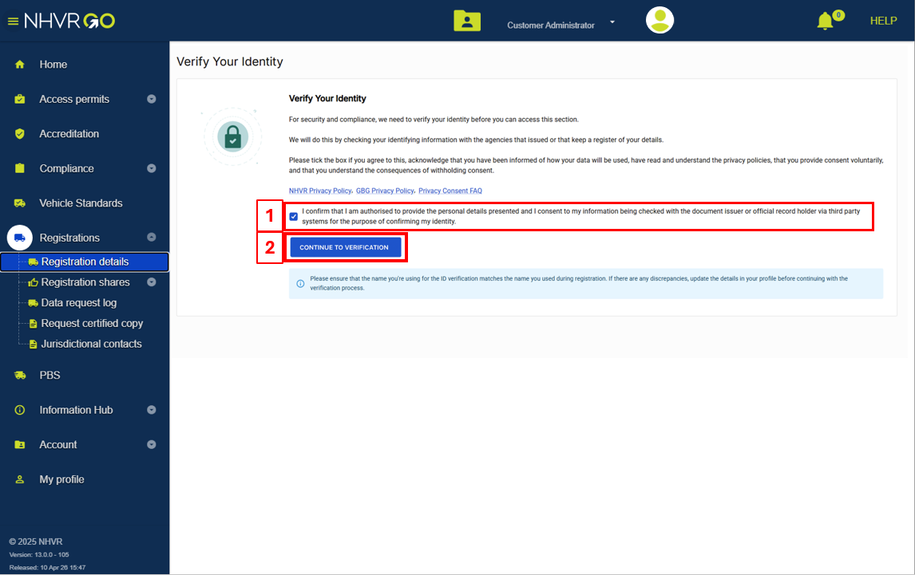
How do I verify my identity?
Click on ‘Registrations’, then ‘Registration Details’.
Tick the confirmation box, then click on ‘Continue to verification’.

Slide 12
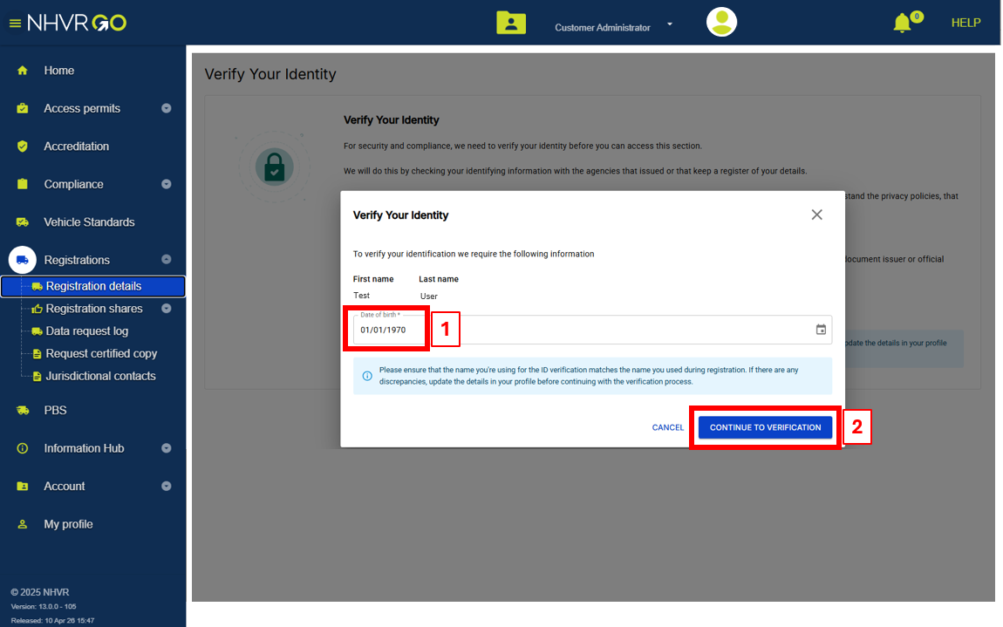
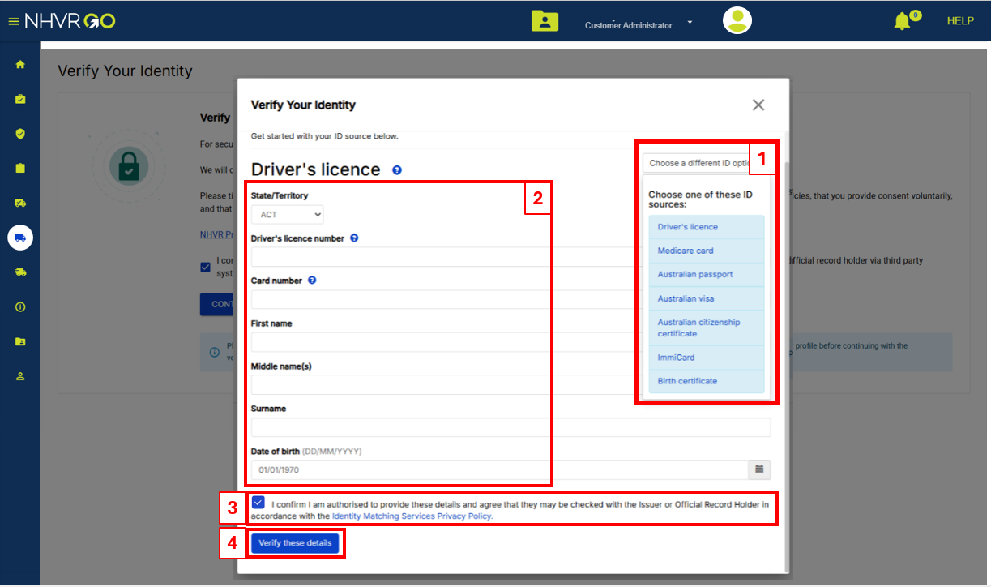
How do I verify my identity?
Your first and last name must match your ID name.
Enter your ‘Date of Birth’,
then click ‘Continue to verification’
Select the ID for verification, then complete the fields.
Tick the confirmation box.
Click ‘Verify these details’.

Slide 13
How do I link vehicle registrations to my NHVR Go account?

Slide 14
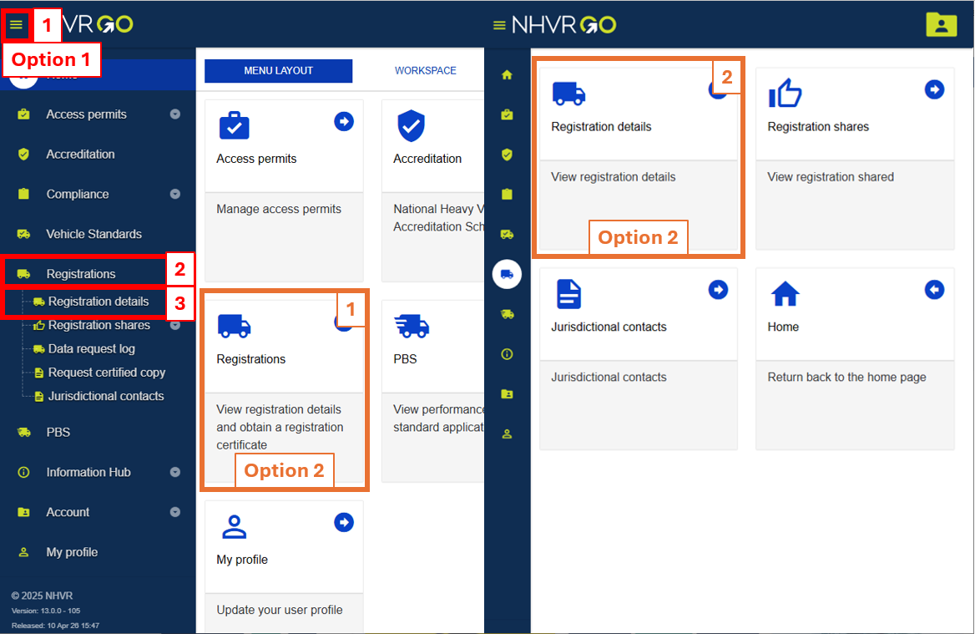
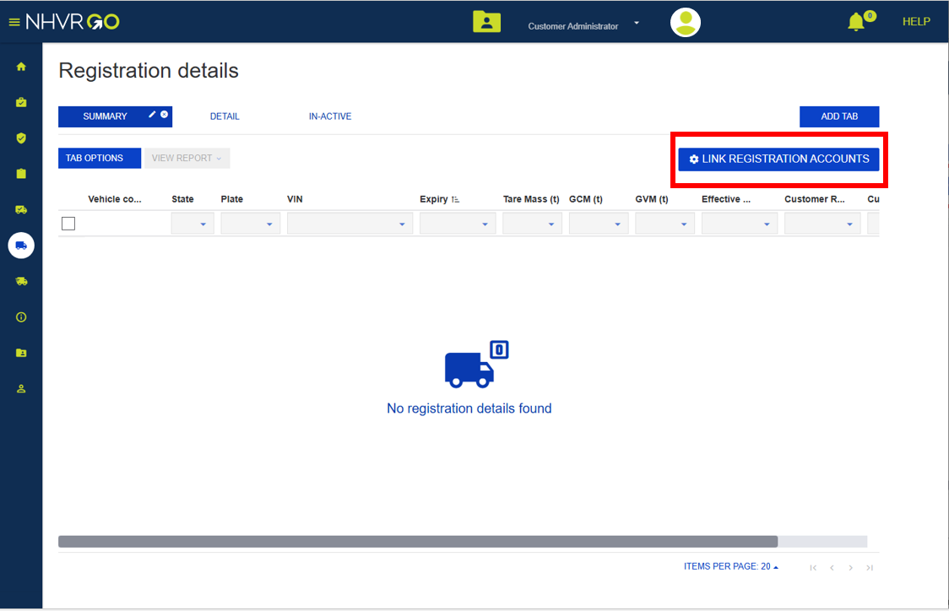
How do I link vehicle registrations to my NHVR Go account?
Click on ‘Registrations’, then ‘Registration Details’.
Click ‘Link Registration Accounts’.

Slide 15
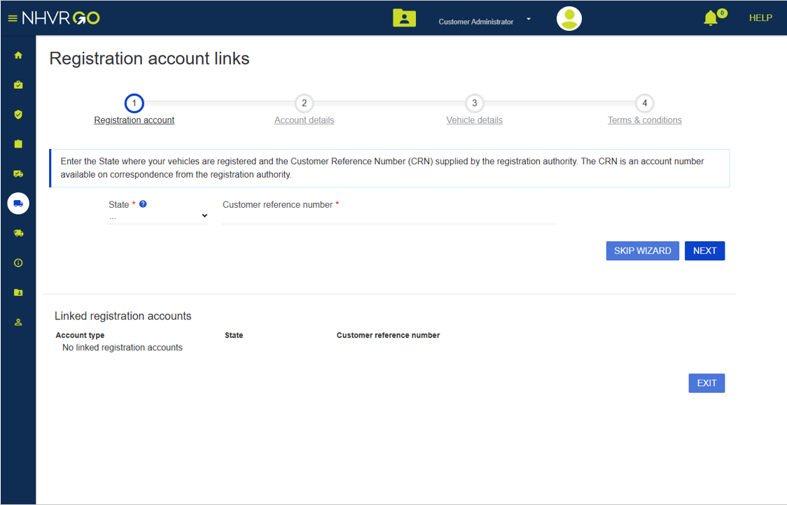
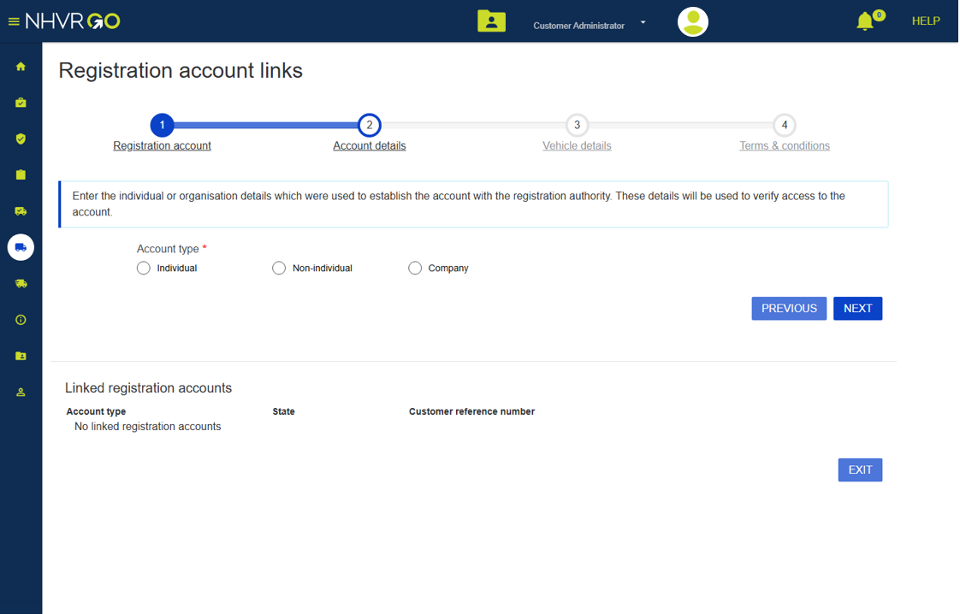
How do I link vehicle registrations to my NHVR Go account?
Select the ‘State’ of registration and enter the ‘Customer Reference Number’.
Select the ‘Account type’ and complete the other required fields.

Slide 16
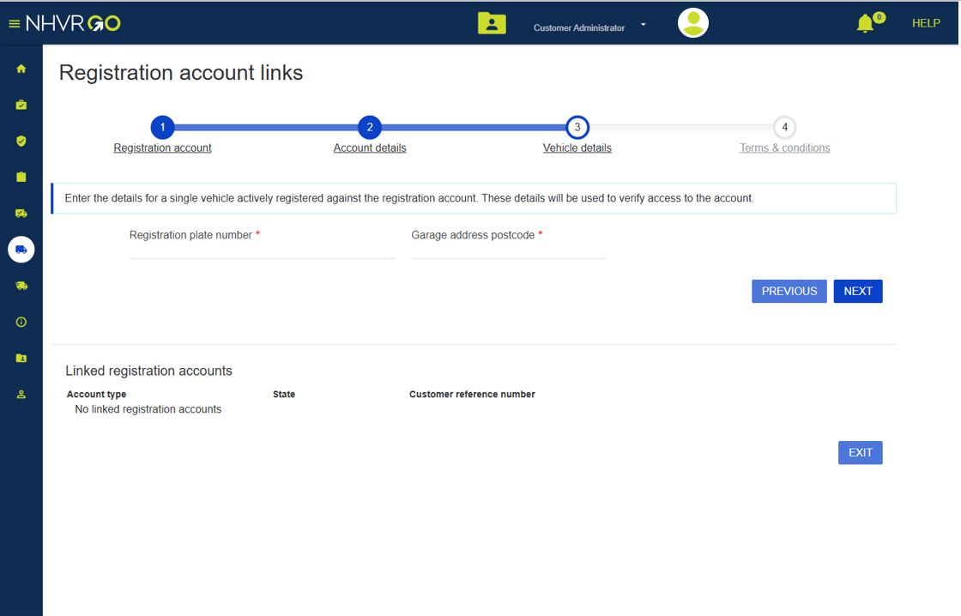
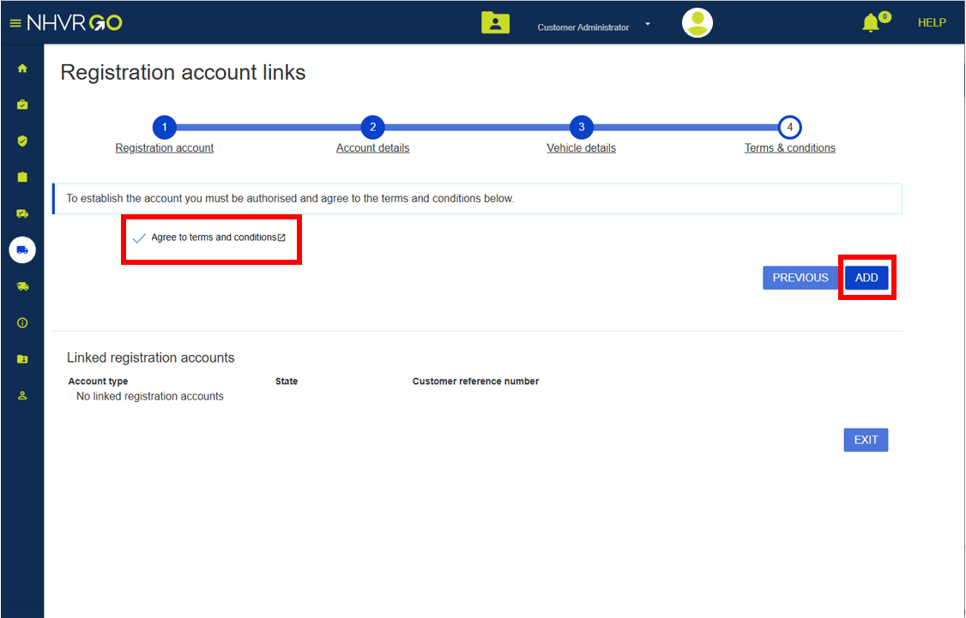
How do I link vehicle registrations to my NHVR Go account?
Enter a ‘Registration plate number’, then enter the ‘Garaged address postcode’.
Review the terms and conditions.
Tick ‘Agree’ to the terms and conditions. Click ‘Add’.

Slide 17
How do I know if I have administrator access to authorise other users?

Slide 18
How do I know if I have administrator access to authorise other users?
Log in to your NHVR Go account.
Go to the ‘Manage Customer Account’ page.

Slide 19
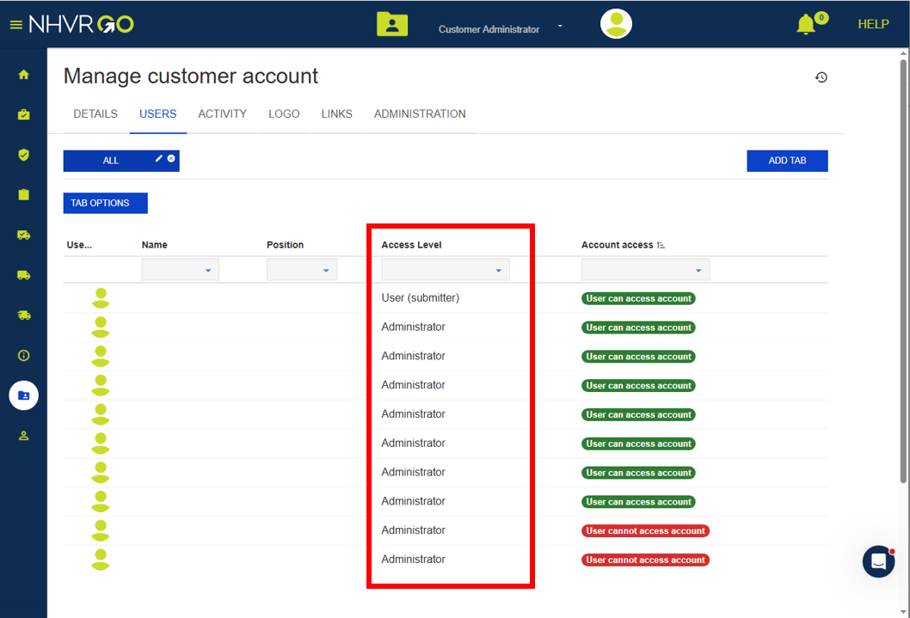
How do I know if I have administrator access to authorise other users?
Click the ‘Users’ tab.
The ‘Access Level’ column shows your level of access (e.g. ‘Administrator’ or others).

Slide 20
How do I authorise a user to view the tool?

Slide 21
How do I authorise a user to view the tool?
Log in to your NHVR Go account.
Go to the ‘Manage Customer Account’ page.

Slide 22
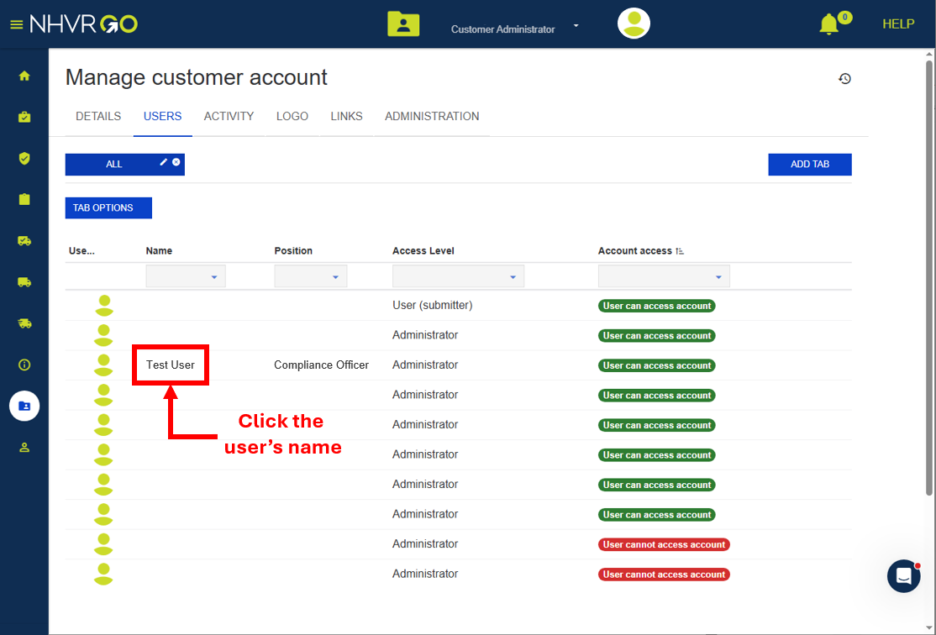
How do I authorise a user to view the tool?
Click the ‘Users’ tab.
Click the user’s ‘Name’.

Slide 23
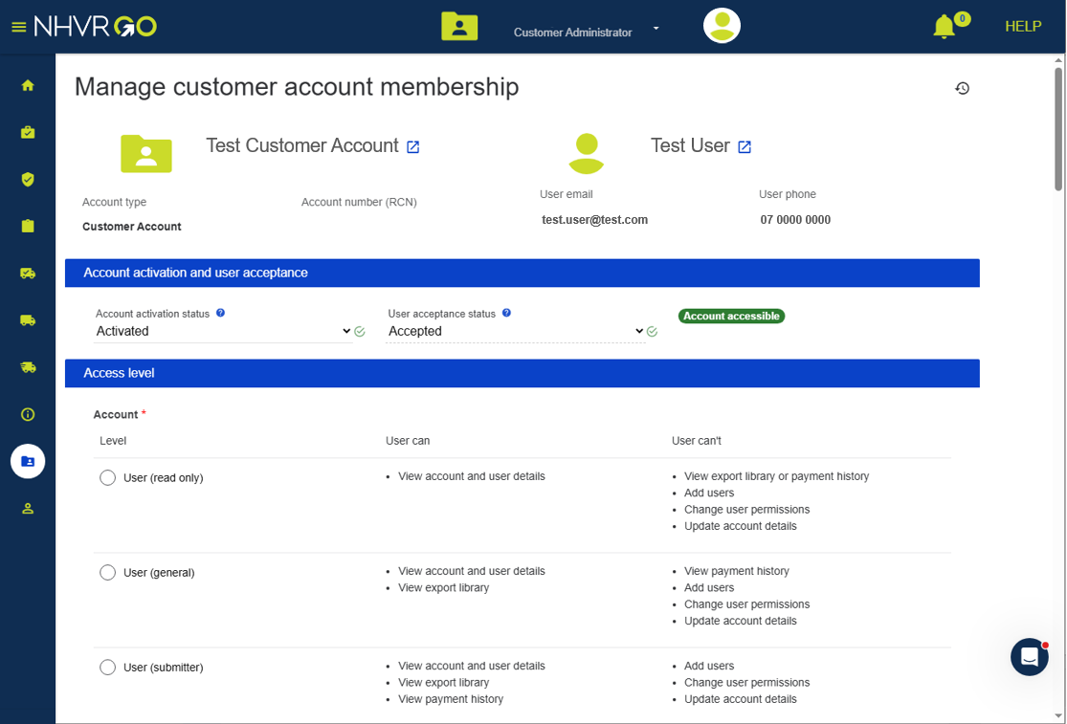
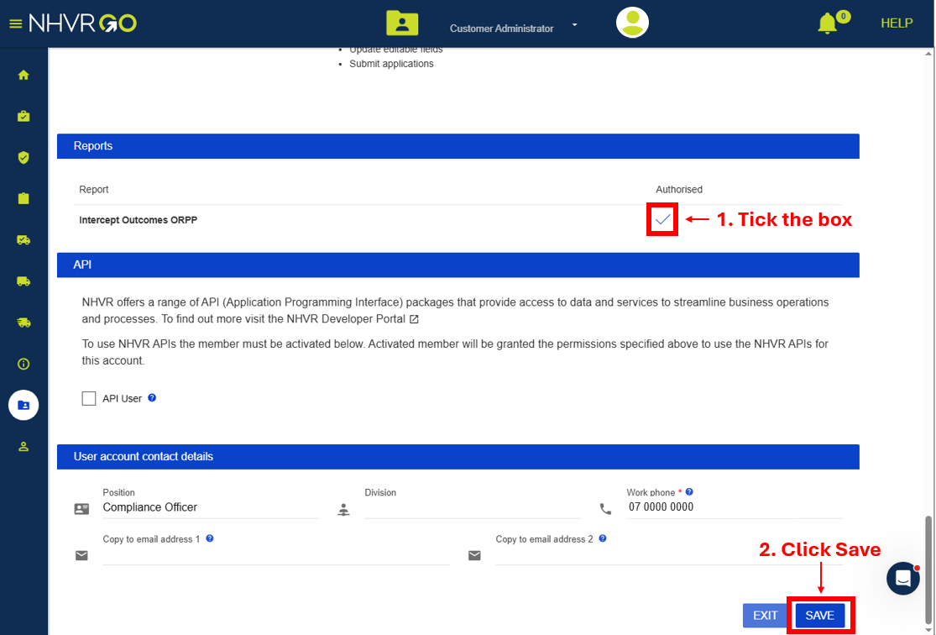
How do I authorise a user to view the tool?
The ‘Manage customer account membership’ page will open.
Scroll to the bottom of the page.
Tick the user’s ‘Authorised’ box for the ‘Intercept outcomes ORRP’.
Click ‘Save’.

Slide 24
Where can I find the tool in NHVR Go?

Slide 25
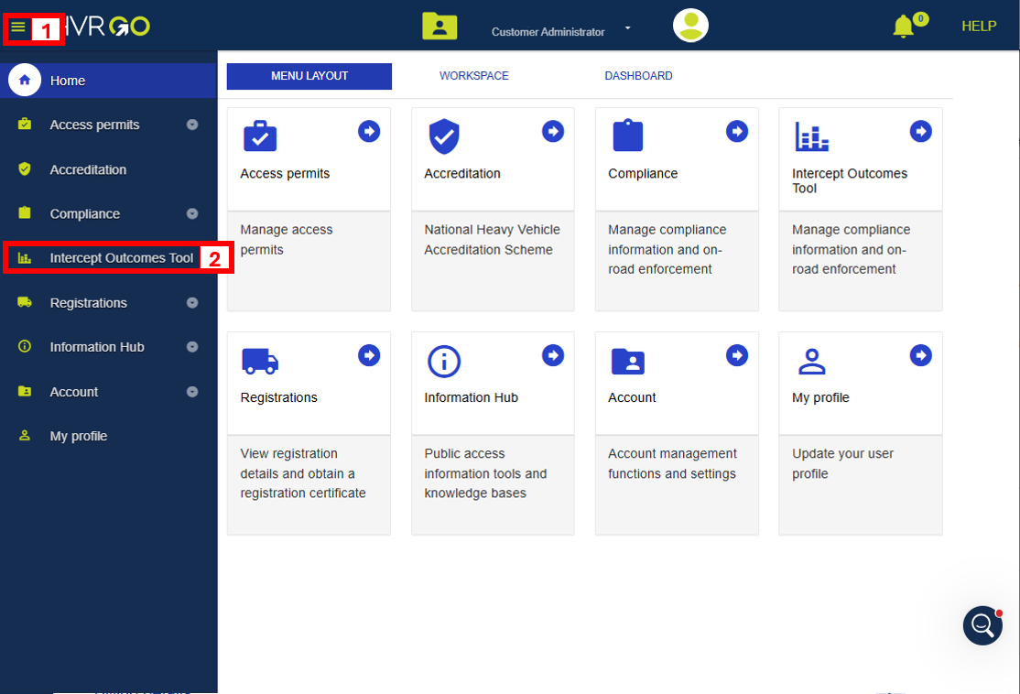
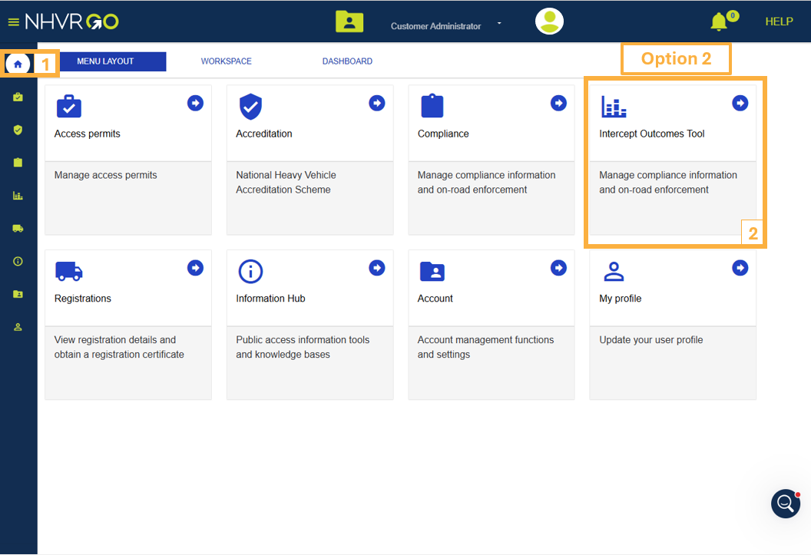
Where can I find the tool in NHVR Go?
Click the menu bar, then select ‘Intercept Outcomes Tool’.
Alternatively, from the home page, click the ‘Intercept Outcomes Tool’ box.
Note: if the ‘Intercept Outcomes Tool’ is not available, please ensure you are authorised to view it.

Slide 26
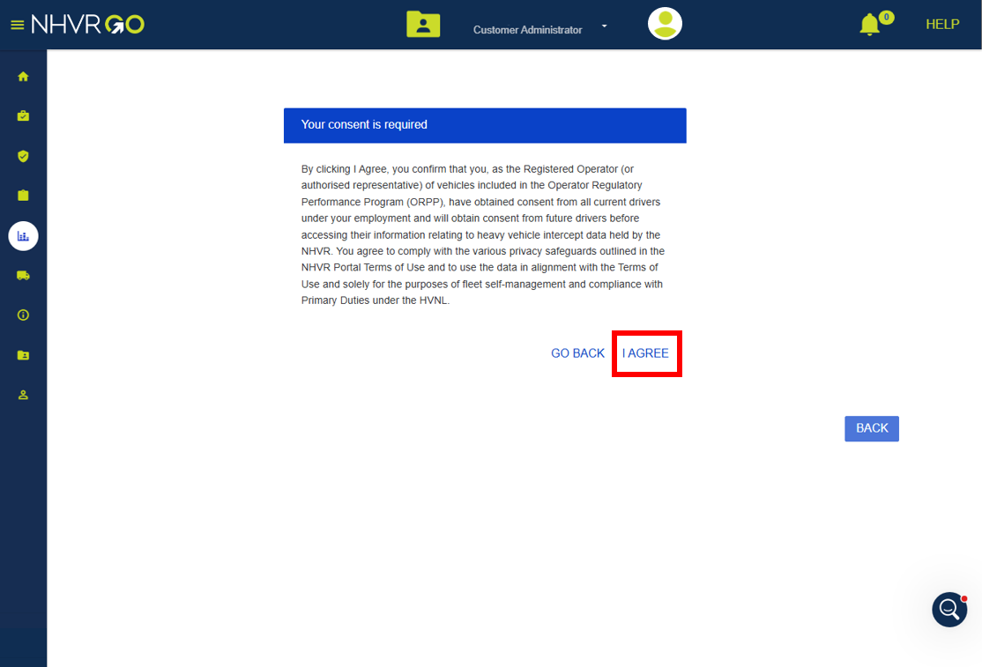
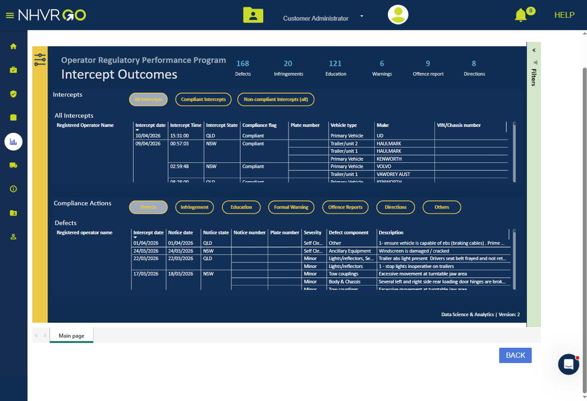
Where can I find the tool in NHVR Go?
The first time any user on an account accesses the tool, the consent statement will appear. Once accepted, it will not appear again.
Review the consent statement and click ‘I Agree’ to continue.
Once you click ‘I Agree’, the tool will load.

Slide 27
Navigating the tool

Slide 28

Navigating the tool – Tool overview
The tool shows:
All NHVR intercepts and the outcomes.
Vehicle details.
State of intercept.
Date and time of intercept.
Compliance actions issued to the vehicle(s).
Defect severity.
Offence category.
HVNL risk level.
Image fill
Notes:
Keep equal spacing between headings
Always use sentence case in headings
To add an image, right-click the image and select Format Shape –
Format Shape > Shape Options > Picture or texture fill > Insert from file >

Slide 29
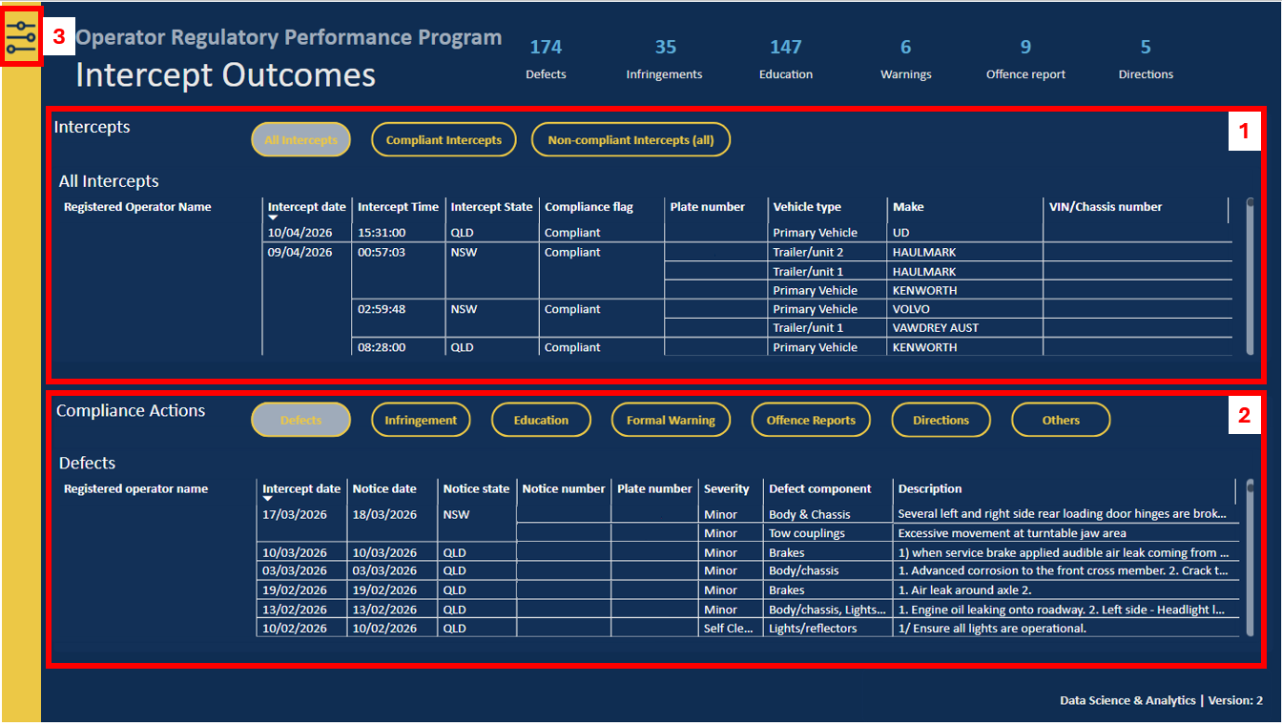
Navigating the tool – Parts of the tool
The tool has 3 main parts:
‘Intercepts’ section
‘Compliance Actions’ section
Filter/slicer tool.
Each of these parts is explored in more detail shortly.
Image fill
Notes:
Keep equal spacing between headings
Always use sentence case in headings
To add an image, right-click the image and select Format Shape –
Format Shape > Shape Options > Picture or texture fill > Insert from file >

Slide 30
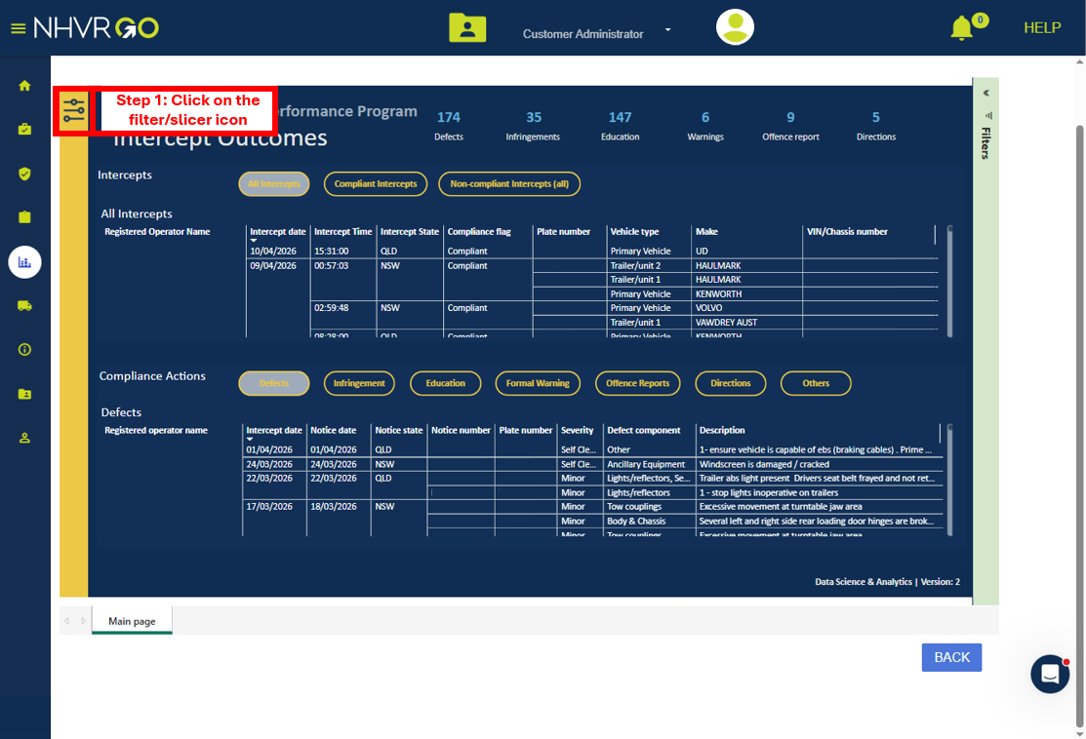
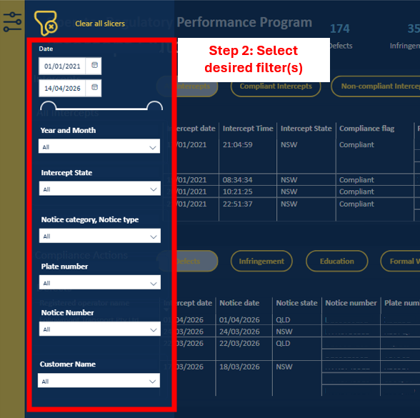
Navigating the tool – How does filtering work
Click on the filter/slicer icon.
Results can be filtered by ‘Date’, ‘Intercept State’, ‘Notice category/type’, ‘Plate number’, and ‘Notice number’.
The tool will automatically update results based on selected filters.

Slide 31
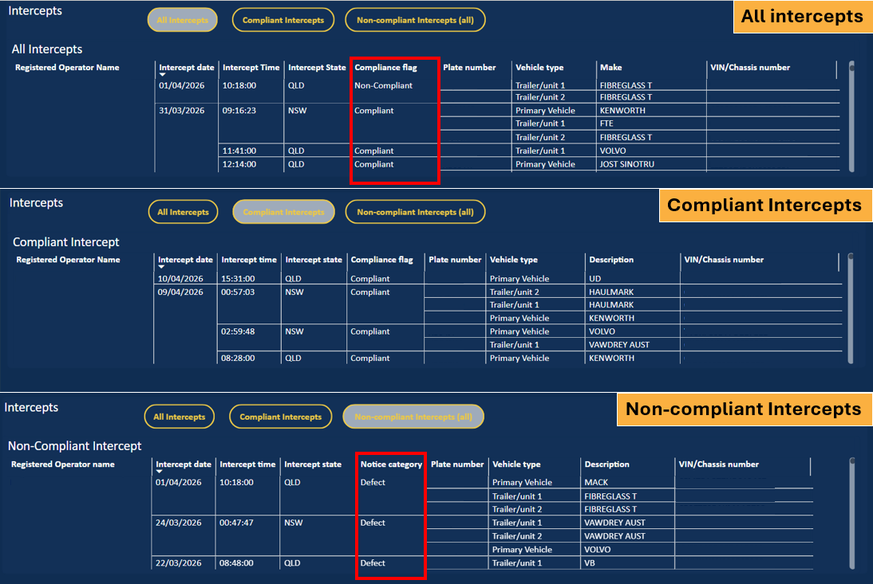
Navigating the tool – Intercepts section
The Intercepts section tool has 3 tables:
‘All intercepts’
‘Compliant Intercepts’
‘Non-compliant Intercepts (all)’.
The ‘All Intercepts’ table displays all intercepts and includes a ‘Compliance flag’ to indicate whether each intercept is compliant or non-compliant.
The ‘Non-compliant Intercepts (all)’ table includes a ‘Notice category' column, which shows the resulting compliance action for each non-compliant intercept.
Image fill
Notes:
Keep equal spacing between headings
Always use sentence case in headings
To add an image, right-click the image and select Format Shape –
Format Shape > Shape Options > Picture or texture fill > Insert from file >

Slide 32
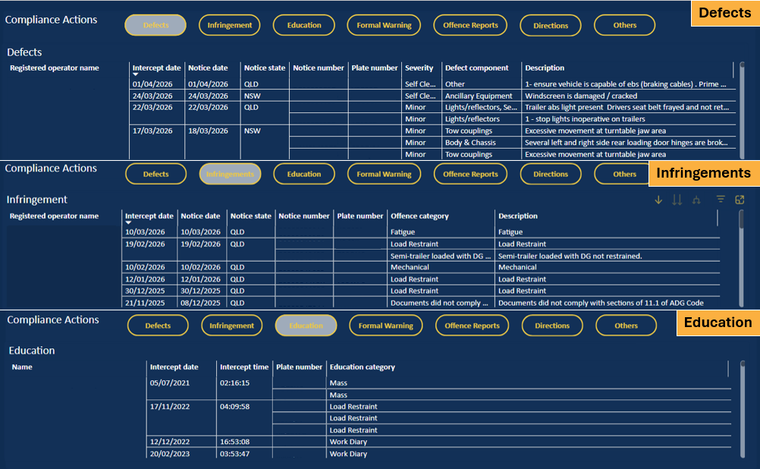
Navigating the tool – Compliance Actions section
The Compliance Actions section has 7 tables:
‘Defects’
‘Infringements’
‘Education’
‘Formal Warning’
‘Offence Reports’
‘Directions’
‘Others’, for example, licence suspension advice, unregistered vehicle advice, etc.
Image fill
Notes:
Keep equal spacing between headings
Always use sentence case in headings
To add an image, right-click the image and select Format Shape –
Format Shape > Shape Options > Picture or texture fill > Insert from file >

Slide 33
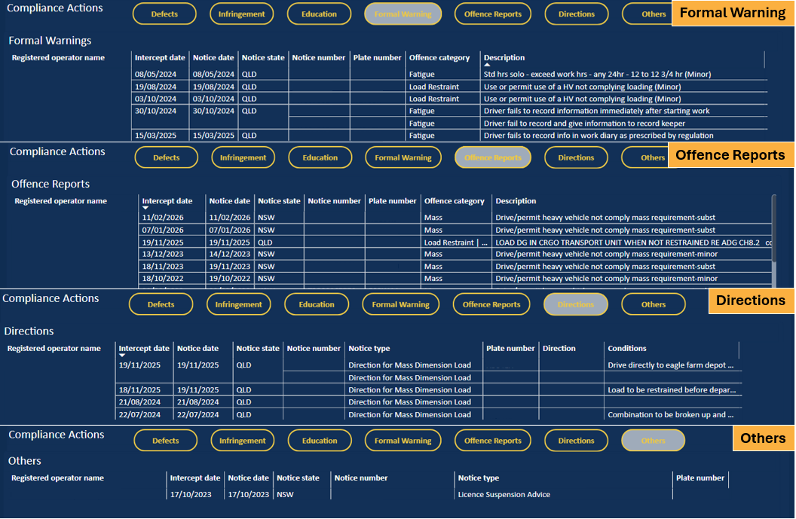
Navigating the tool – Compliance Actions section
Each table at a minimum will show:
‘Intercept Date’
‘Notice State’
‘Plate number ’
‘Description’ or ‘Offence category’.
Image fill
Notes:
Keep equal spacing between headings
Always use sentence case in headings
To add an image, right-click the image and select Format Shape –
Format Shape > Shape Options > Picture or texture fill > Insert from file >

Slide 34
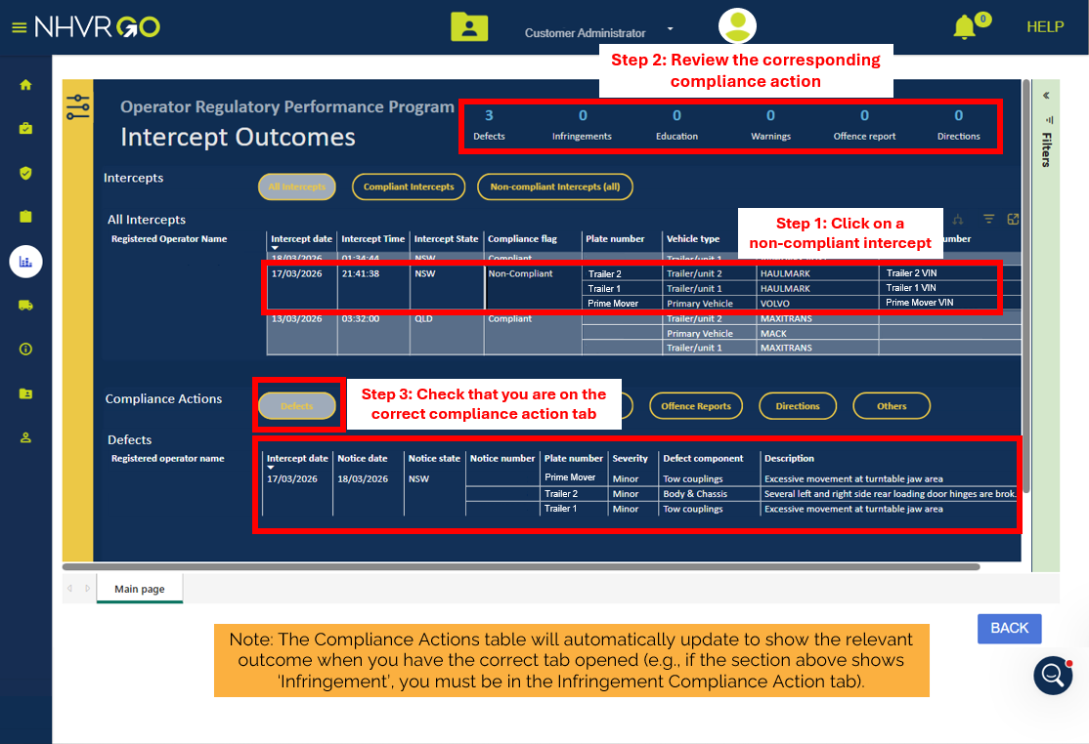
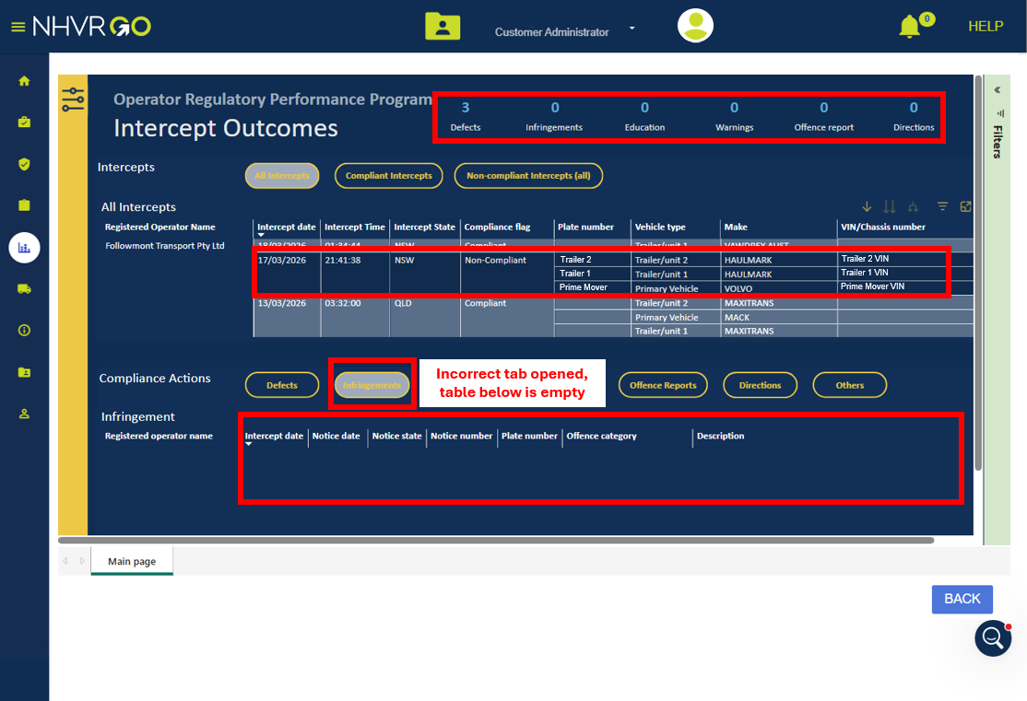
Navigating the tool – Other tool features
When you select a non-compliant intercept from the Intercepts table, the Compliance Actions table will update to show relevant results.
Results will only display if the correct ‘Compliance Actions’ tab is opened; otherwise, the table will be empty.

Slide 35
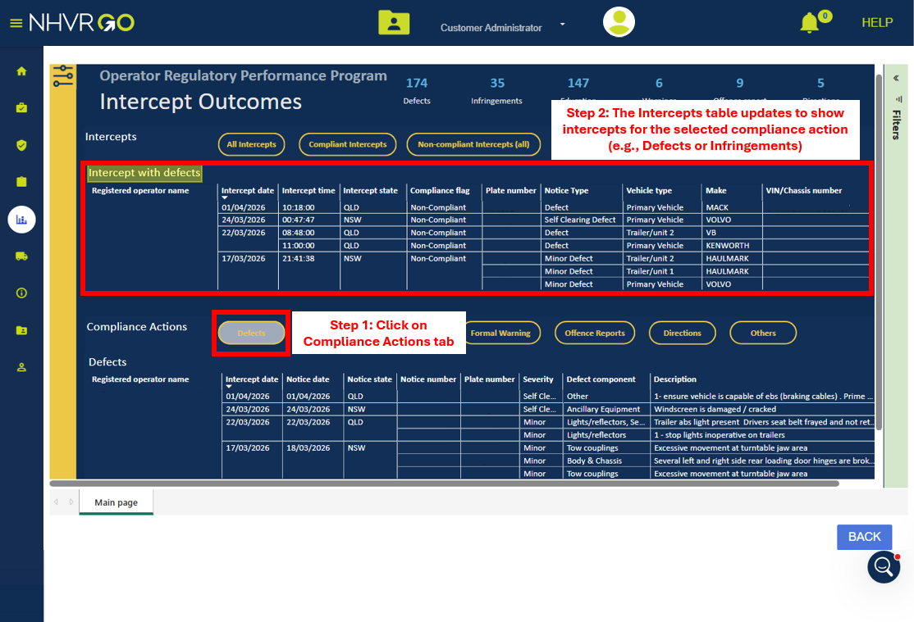
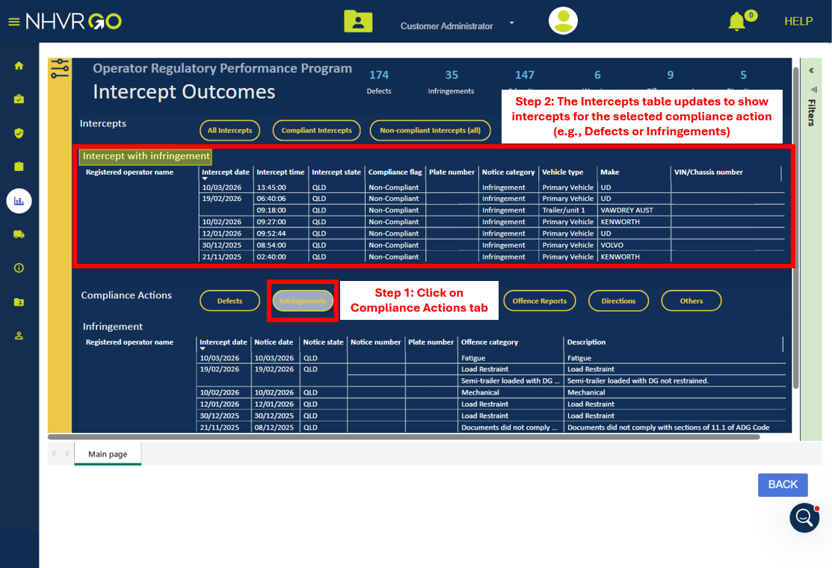
Navigating the tool – Other tool features
When you select a ‘Compliance Actions’ tab, the ‘Intercepts table’ updates to display only intercepts related to that action. For example, ‘Defects’, ‘Infringements’, etc.

Slide 36
What you can see and why

Slide 37
Navigating the tool – Other tool features
The data is refreshed every 24 hours.
The tool does not replace paper-based notices
Notices cannot be downloaded or cleared via the tool
Vehicle combinations with more than one owner
For vehicle combinations with more than one owner, the compliance action will only be visible to the owner of the non-compliant component (i.e., prime mover or trailer).
If you are not the owner of the non-compliant component or if you have not linked the vehicle to your NHVR Go account, the non-compliant intercept will appear in your tool, but you will not see the associated compliance action.
Example: If your prime mover was towing another company’s trailer and the defect was issued to the trailer, you will see the non-compliant intercept but not the compliance action.

Slide 38




Thank you
For more information:
13 NHVR (13 64 87)
info@nhvr.gov.au
nhvr.gov.au
nhvrsocial
nhvrsocial
NHVR
National Heavy Vehicle Regulator
Notes:
End slide

